Slide 1
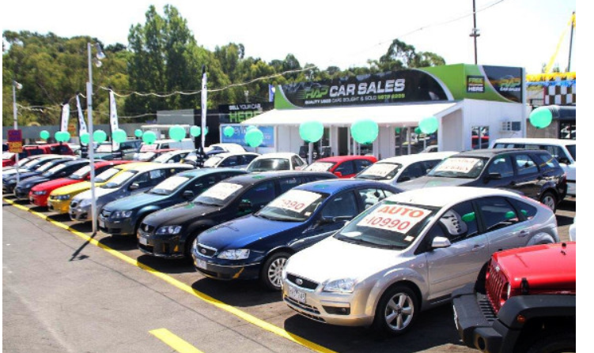

Car Sales
Category/Area Focus
by Prabhat Verma

Slide 2
Study
Analysis for Most Lucrative Car Category- Revenue

Slide 3
Data Sources
There are 12 variables and 9576 observations
It consists of 87 unique companies with various engine types like petrol, diesel, etc..
It consists for Sedans, Crossovers, hatchbacks etc
Data Range is from year 1953-2016

Slide 4
Problem Statement
Cars Sold per year?
Company has highest market share by volume ( no: of cars sold )?
Company has highest market share by Revenue Earned?
BodyType - Highest market share by volume?
Distribution of Bodytype of Top 5 companies by volume?
Distribution of Bodytype of Top 5 companies by Revenue?

Slide 5
Analyze Patterns
There are various factors like engine Volume, price, engine type, Drive type which affect the sales pattern so the key is to analyze and find patterns and dependencies by :
Mean Price Body Type
By Engine Volume
By Mileage
By Engine Type
By Body and Engine Type
Percentage Distribution of Brand and Body( by Count / Revenue)
By adding Drive Type

Slide 6
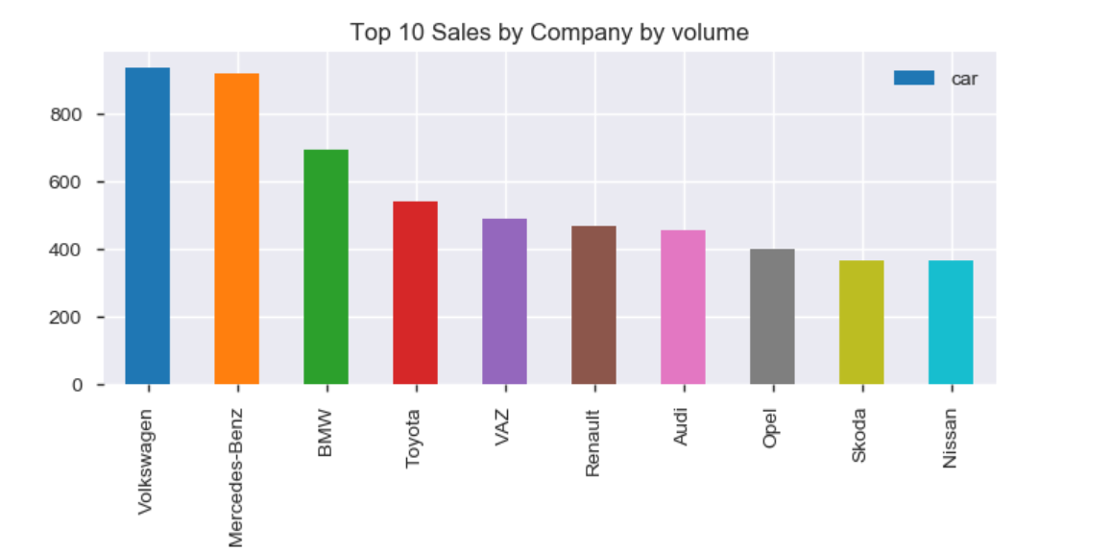
Top companies by Volume
Top 5 by Volume
Volkswagen 936
Mercedes-Benz 921
BMW 694
Toyota 541
VAZ 489

Slide 7
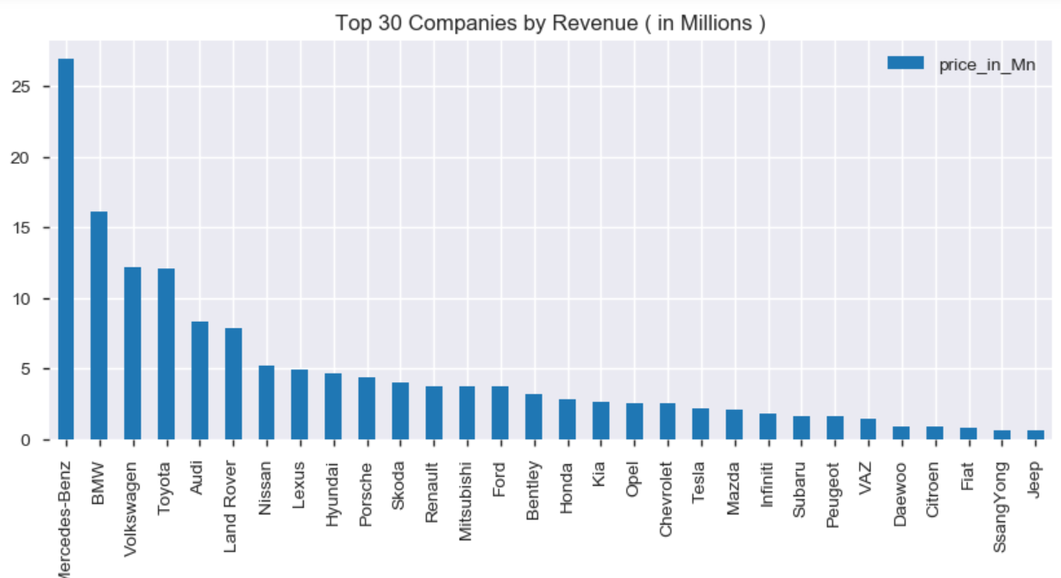
Top companies by Revenue
Top 5 by Revenue in Millions
Mercedes-Benz 26.92
BMW 16.11
Volkswagen 12.15
Toyota 12.09
Audi 8.33

Slide 8
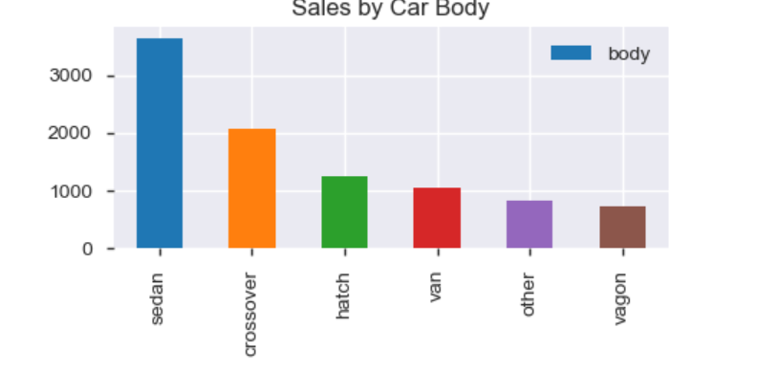
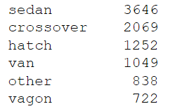
BodyType -by number

Slide 9
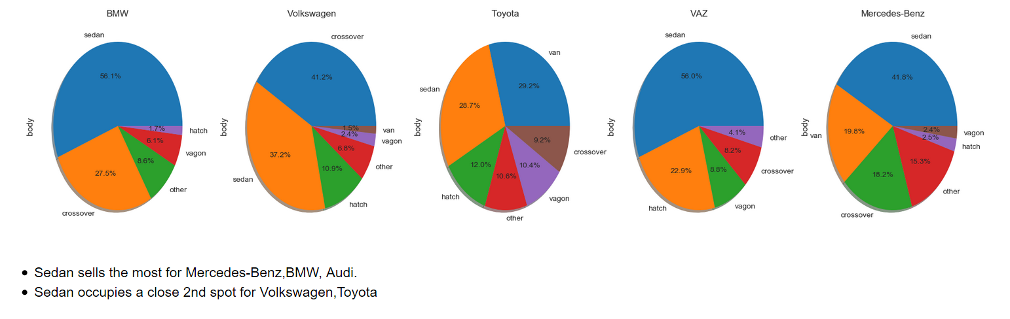
Distribution of Bodytype of Top 5 companies by volume
Top 5 by Volume
Volkswagen 936
Mercedes-Benz 921
BMW 694
Toyota 541
VAZ 489

Slide 10
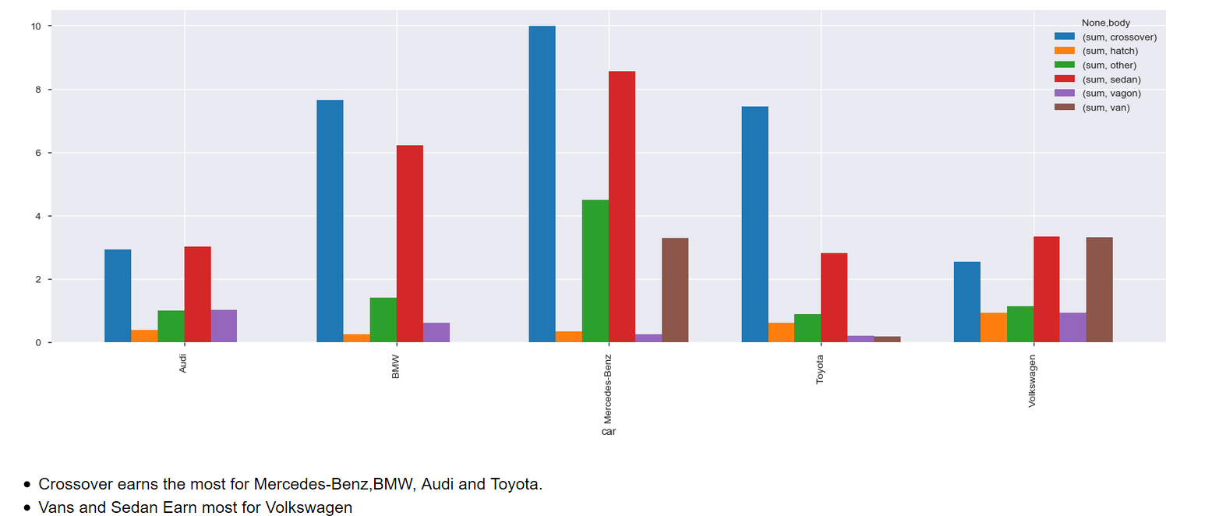
Distribution of Bodytype of Top 5 companies by Revenue
Top 5 by Volume
Volkswagen 936
Mercedes-Benz 921
BMW 694
Toyota 541
VAZ 489

Slide 11
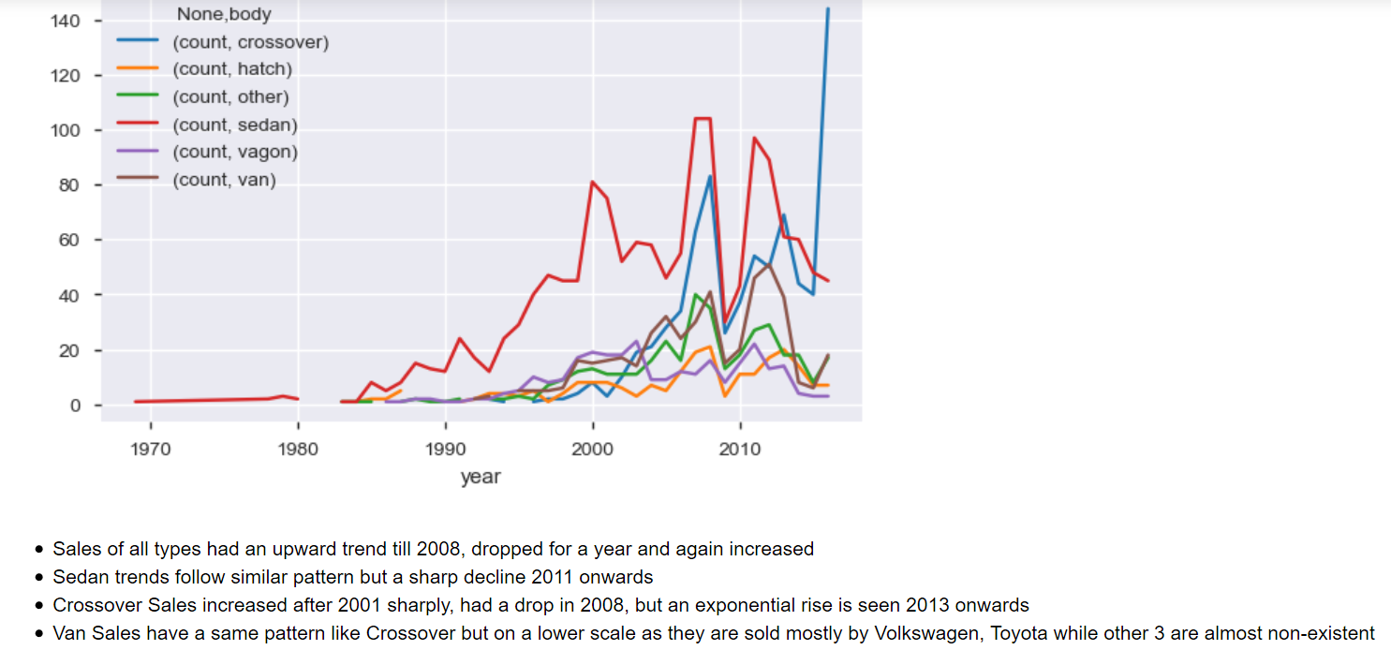
trend Analysis for Body Types

Slide 12
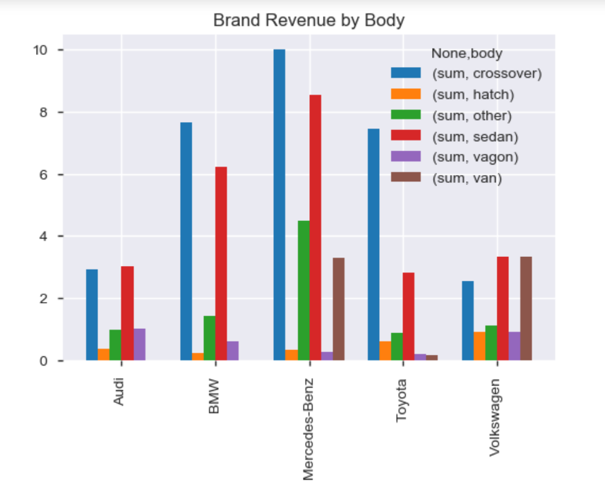
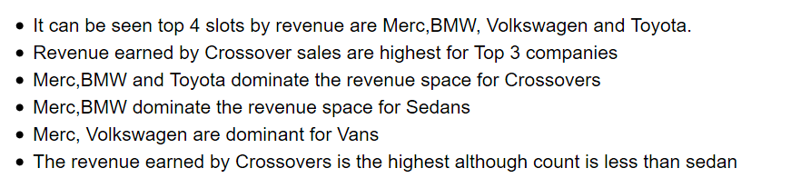

Slide 13

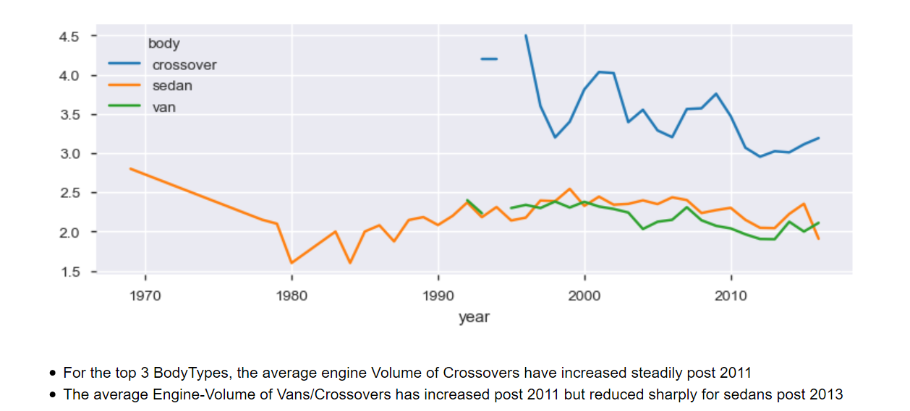

Slide 14

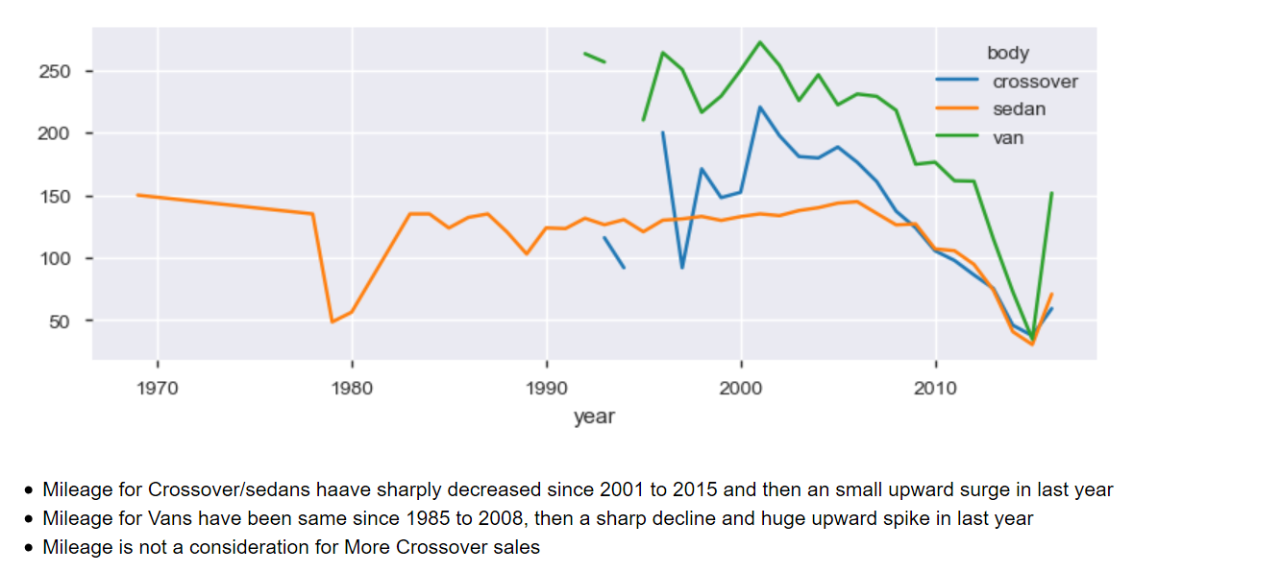

Slide 15

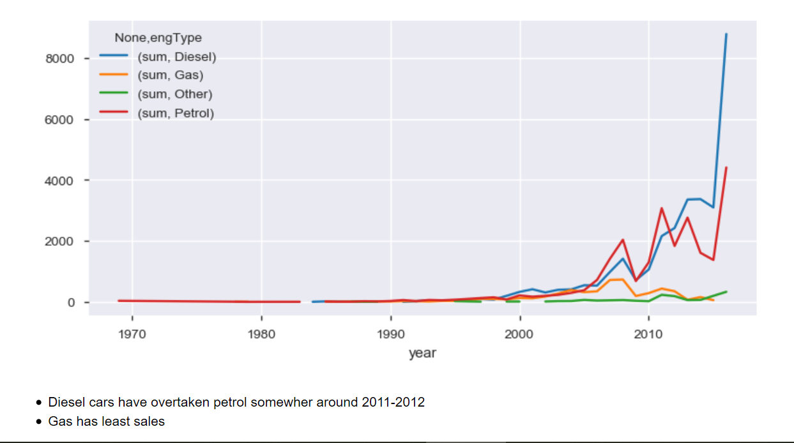

Slide 16
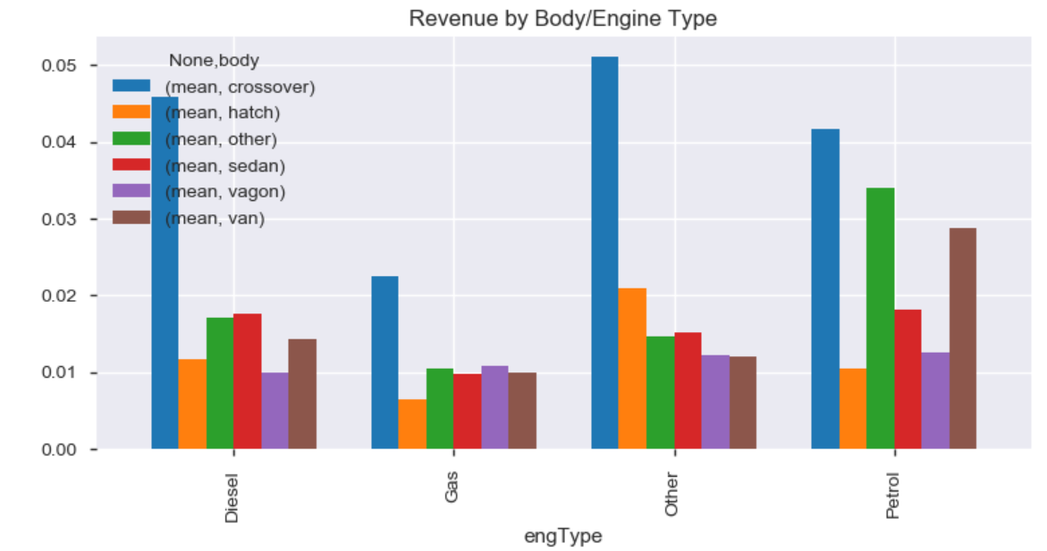
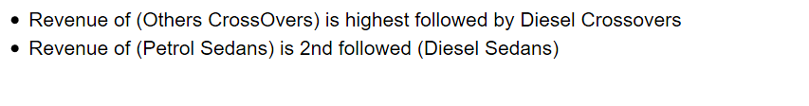

Slide 17
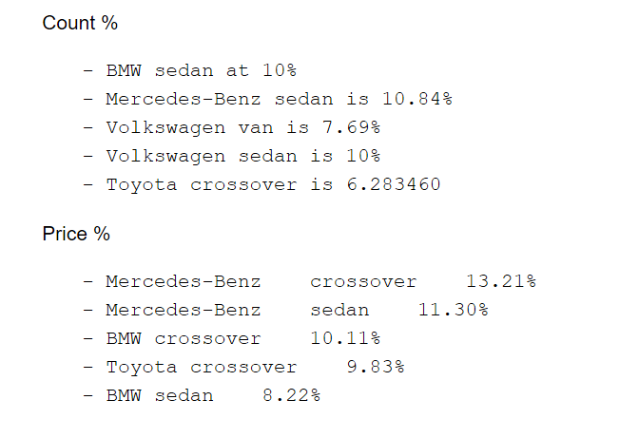

Slide 18

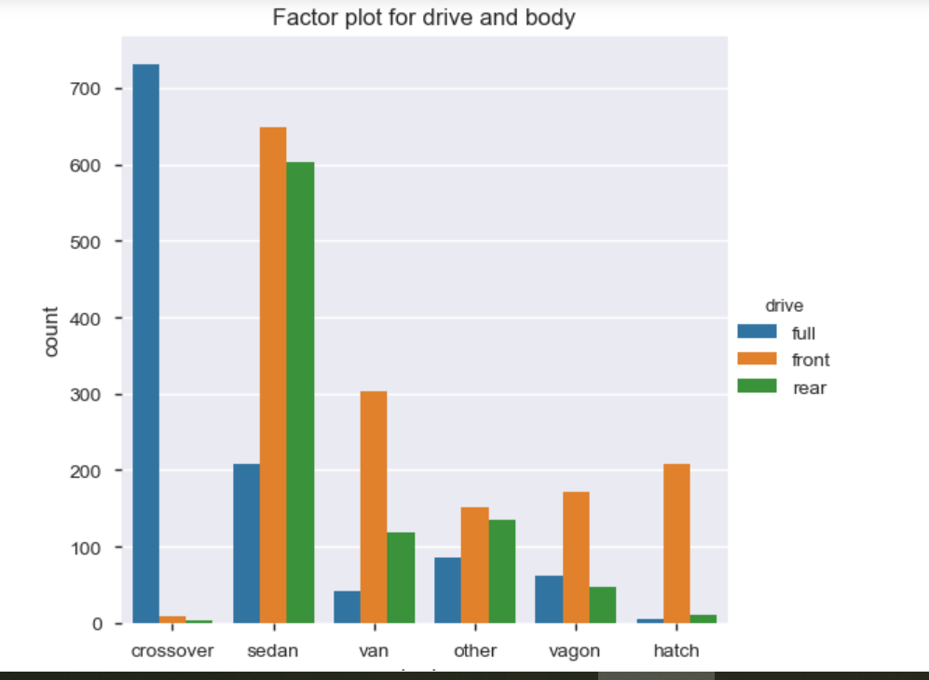

Slide 19
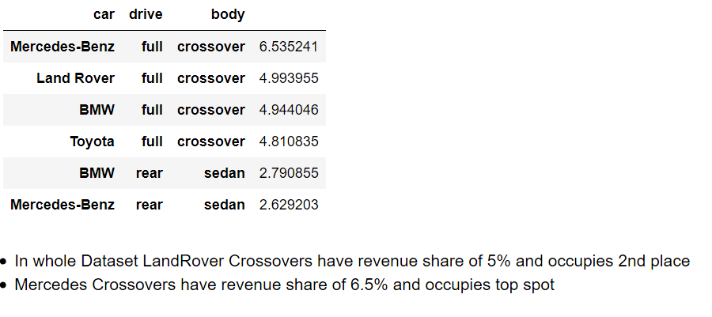
Revenue Percentage by Drive and BodyType

Slide 20
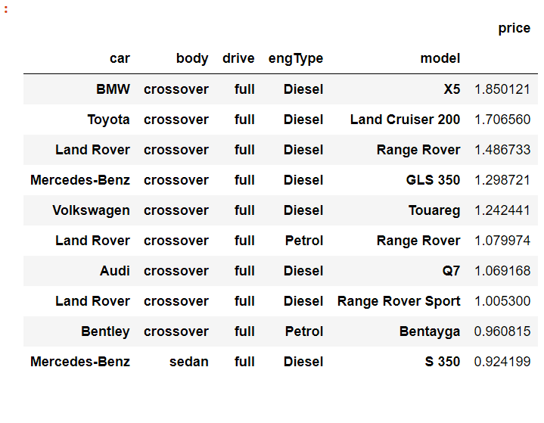
Top Selling Models by revenue
BMW | crossover | full | Diesel | X5 | 1.85 %
Toyota | crossover | full | Diesel | Land Cruiser 200 | 1.70 %
Land Rover | crossover | full | Diesel | Range Rover | 1.48 %

Slide 21
Conclusions
- Full wheel Crossovers have the top 3 revenue share.
- Mercedes-Benz full crossover at 6.53%
- Land Rover full crossover at 4.99%
- BMW full crossover at 4.94%
- Topmost selling are still Sedans
- There is a shift towards more power and diesel engines
Mercedes-Benz full crossovers lead the chart when analysis was run down on the
basis of drivetype and body
- Diesel Mercedes-Benz full crossovers have share of 3.39%.
- BMW X5 diesel has highest revenue share category

